Slide 1
Introduction to Regression
Ann Thapar

Slide 2
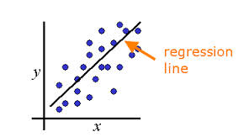
Introduction to Regression
Intuition
Simple
t-statistics
Making Predictions
Correlation
R²

Slide 3
What is regression?
Dependence of one variable (DV) on one or more explanatory or independent variables (IVs).
Types of relationships
Correlation
Causal
The technique is …
Often referred to as fitting a line to the data
Used to calibrate a statistical model
Widely used for solving business problems
Notes:
Involves the study of the dependence of one variable, the dependent variable, on one or more other variables, the explanatory or independent variables.
Types of relationships
Correlation
Causal
Most widely used technique for solving business problems
Statistical technique to calibrate a model
Often referred to as fitting a line to the data

Slide 4
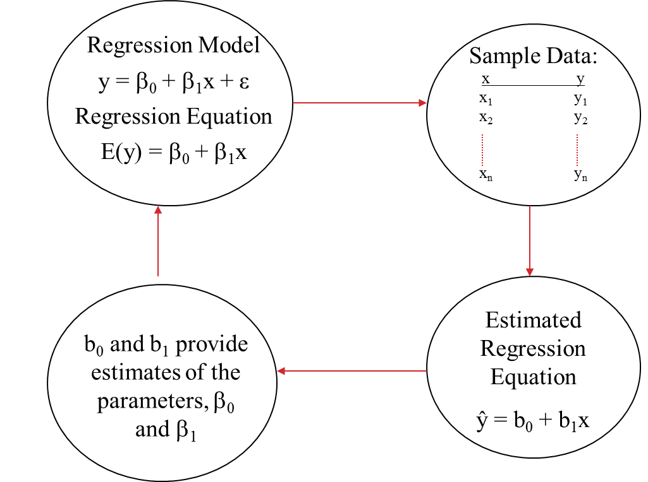
Process for Simple Regression
Notes:
This slide highlights the terminology and process for simple regression.
The outputs from the regression (b₁ and b₀) are estimates of the population parameters (β₀ and β₁).

Slide 5
Assumptions of Regression
1
E(e_{i}) = 0
2
Var(e_{i}) = constant
3
e_{i} are normally distributed
4
e_{i} are independent
Notes:
Violation of the assumptions are considered in Chapter 6 of Dielman.

Slide 6
Let’s get started…
Restaurant owner wants to develop an equation to predict sales.
What is your first, best guess at the predicted value of the DV?
How accurate is this prediction?
What variable is the dependent variable? Why?

Slide 7
Example: Restaurant Sales
Year | Sales
1 | £15,713
2 | £12,937
3 | £12,872
4 | £16,227
5 | £15,388
6 | £13,180
7 | £17,199
8 | £20,674
9 | £20,350
10 | £14,444
11 | £17,530
12 | £16,711
13 | £9,715
14 | £12,248
15 | £13,856
16 | £15,285
17 | £15,620
18 | £17,158
19 | £17,800
Notes:
These data are shown on the data sheet of Restaurant Data.xlsx.
The owner has sales from last 19 years.

Slide 8
Questions to Be Answered
Restaurant owner wants to develop an equation to predict sales.
What is your first, best guess at the predicted value of the DV?
How accurate is this prediction?
What variable is the dependent variable (DV)? Why?

Slide 9
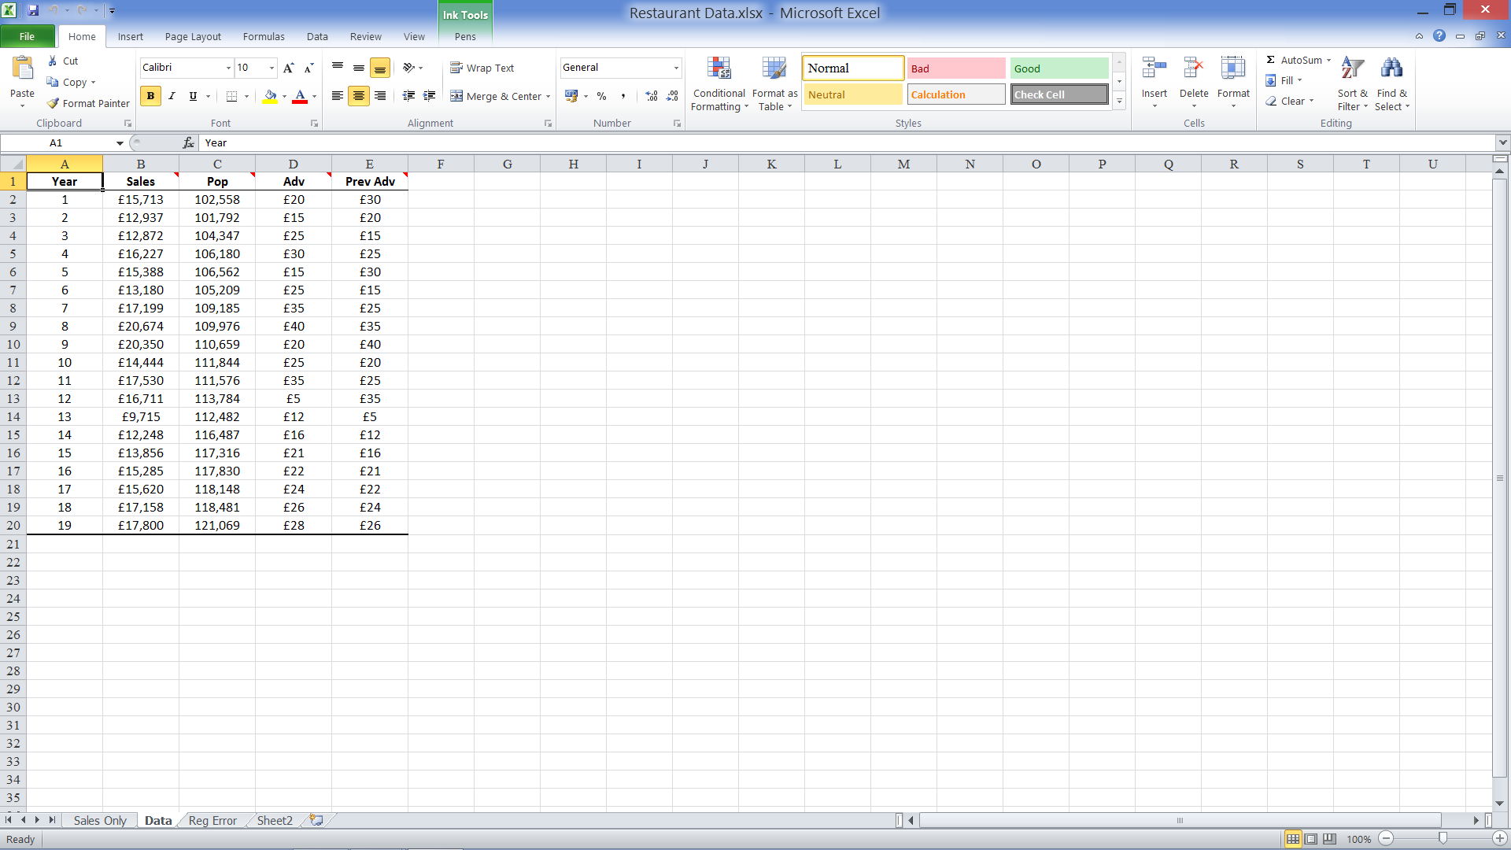
Example: Restaurant Sales
Notes:
Owner also has data on population, advertising, and previous advertising
These data are shown on the Data sheet of Restaurant Data.xlsx.

Slide 10
What next?
Which column should we look at most closely?
Which variable has highest correlation with the dependent variable?
Why is this the best candidate for improving our prediction?
 | Sales | Pop | Adv | Prev Adv
Sales | 1.000
Pop | 0.144 | 1.000
Adv | 0.515 | 0.001 | 1.000
Prev Adv | 0.894 | -0.086 | 0.162 | 1.000

Slide 11
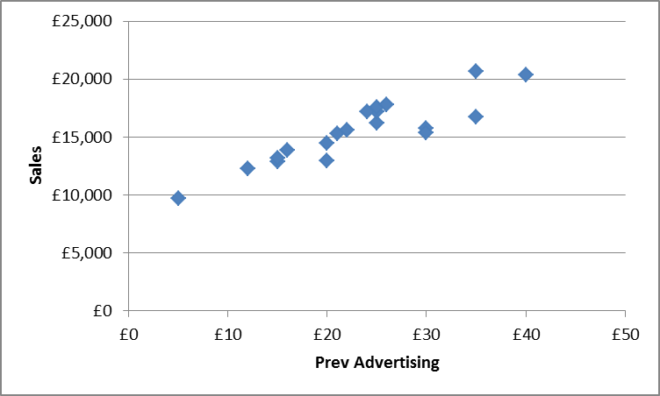
Is this what we expected?
Year | Sales | Prev Adv
1 | £15,713 | £30
2 | £12,937 | £20
3 | £12,872 | £15
4 | £16,227 | £25
5 | £15,388 | £30
6 | £13,180 | £15
7 | £17,199 | £25
8 | £20,674 | £35
9 | £20,350 | £40
10 | £14,444 | £20
11 | £17,530 | £25
12 | £16,711 | £35
13 | £9,715 | £5
14 | £12,248 | £12
15 | £13,856 | £16
16 | £15,285 | £21
17 | £15,620 | £22
18 | £17,158 | £24
19 | £17,800 | £26

Slide 12
Graphical Form
Ŷ= intercept + (slope)*X
Ŷ= b₀ + (b₁)*X
Sales
Slope = b₁
Intercept = b₀
1 Unit of Prev. Adv. (£1,000)
Prev. Adv.

Slide 13
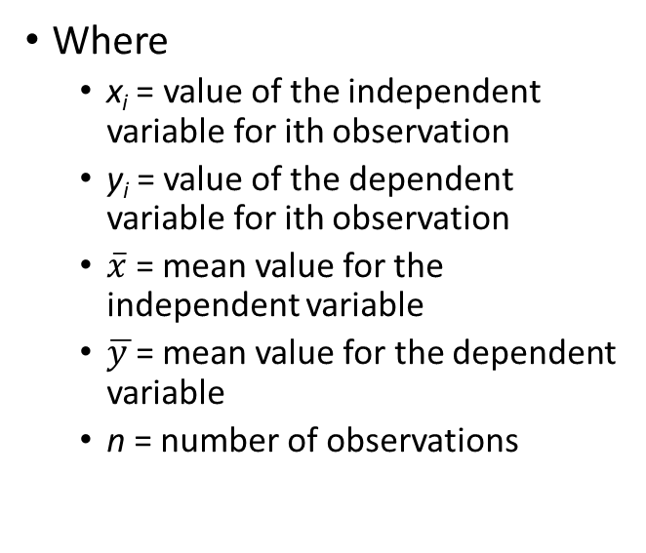
Slope & Intercept Equations
Where
x_{i} = value of the independent variable for ith observation
y_{i} = value of the dependent variable for ith observation
$\overline{x}$ = mean value for the independent variable
$\overline{y }$= mean value for the dependent variable
n = number of observations
Notes:
Note that b₁ is based on actual and mean values of x and y.
b₀ is a balancing value that anchors the line onto the vertical axis.
Without this value a line with the slope (b₁) could be any where on the plane.

Slide 14
Graphical Form
Ŷ= intercept + (slope)*x
Sales
Slope = 282.832
Intercept = 8956.742
1 Unit of Prev. Adv. (£1,000)
Prev. Adv.

Slide 15
Verbal Form
Where
b₀ = 8956.742
b₁= 282.832
282.832
Change in Sales Associated with a Unit change in Previous Advertising
8956.742
Level of Sales w/o Previous Advertising
Units of Previous Advertising
Predicted Sales
=
*
+

Slide 16

Making Predictions
The equation:
$\hat{\text{Y}} \text{=} \text{8956.742} \text{+} \text{(282.832∗}\text{x}\text{)}$
What is predicted level of sales?
if X = 0?
if X = 10?
if X = 25?
Answers:

Slide 17
Predicting Sales w/ Equation
Year | Sales | Prev. Adv. | Pred. Sales
1 | £15,713 | £30
2 | £12,937 | £20
3 | £12,872 | £15
4 | £16,227 | £25
5 | £15,388 | £30
6 | £13,180 | £15
7 | £17,199 | £25
8 | £20,674 | £35
9 | £20,350 | £40
10 | £14,444 | £20
11 | £17,530 | £25
12 | £16,711 | £35
13 | £9,715 | £5
14 | £12,248 | £12
15 | £13,856 | £16
16 | £15,285 | £21
17 | £15,620 | £22
18 | £17,158 | £24
19 | £17,800 | £26
Open “Reg Error” worksheet
Year
Sales
Prev. Adv.
Calculate Pred. Sales
Use Prev. Adv. Data
Use the regression equation
Notes:
D2 = Sheet3!$B$17+(Sheet3!$B$18*C2)
‘Sheet3!’ identifies the sheet where regression output is located
$B$17 and $B$18 are the cells on the regression worksheet where the coefficients are located
Be sure to include the ‘$’ signs so that when the formula is copied these cells don’t change

Slide 18
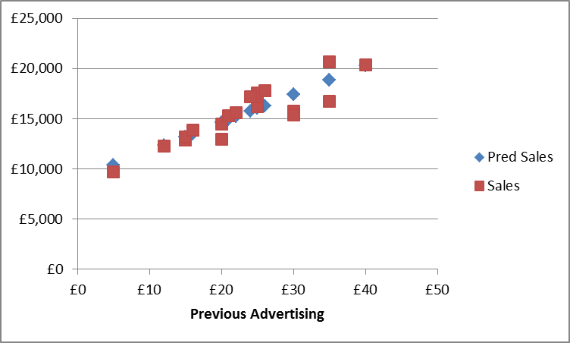
Actual vs. Predicted Values

Slide 19
Are these Predictions Better?
Year | Sales | Prev. Adv. | Pred Sales | Error | Error Squared
1 | £15,713 | £30 | £17,442 | -£1,729 | 2,988,408
2 | £12,937 | £20 | £14,613 | -£1,676 | 2,810,255
3 | £12,872 | £15 | £13,199 | -£327 | 107,074
4 | £16,227 | £25 | £16,028 | £199 | 39,784
5 | £15,388 | £30 | £17,442 | -£2,054 | 4,217,689
6 | £13,180 | £15 | £13,199 | -£19 | 369
7 | £17,199 | £25 | £16,028 | £1,171 | 1,372,315
8 | £20,674 | £35 | £18,856 | £1,818 | 3,305,629
9 | £20,350 | £40 | £20,270 | £80 | 6,397
10 | £14,444 | £20 | £14,613 | -£169 | 28,690
11 | £17,530 | £25 | £16,028 | £1,502 | 2,257,382
12 | £16,711 | £35 | £18,856 | -£2,145 | 4,600,429
13 | £9,715 | £5 | £10,371 | -£656 | 430,208
14 | £12,248 | £12 | £12,351 | -£103 | 10,553
15 | £13,856 | £16 | £13,482 | £374 | 139,836
16 | £15,285 | £21 | £14,896 | £389 | 151,155
17 | £15,620 | £22 | £15,179 | £441 | 194,441
18 | £17,158 | £24 | £15,745 | £1,413 | 1,997,390
19 | £17,800 | £26 | £16,310 | £1,490 | 2,218,988
 |  |  | Sum | £0 | £26,876,991
Create Error column
Sales – Pred Sales
Sum errors
Create Error Squared column
Square each error
Sum the squared errors
How does this sum compare to the sum of squared errors from the baseline prediction?
Notes:
Error = Actual Sales – Predicted Sales = B2 – D2
Error Squared = E2^2
Create sum of the columns E and F in Row 21

Slide 20
Are these Predictions Better?
Year | Sales | Prev. Adv. | Pred Sales | Error | Error Squared
1 | £15,713 | £30 | £17,442 | -£1,729 | 2,988,408
2 | £12,937 | £20 | £14,613 | -£1,676 | 2,810,255
3 | £12,872 | £15 | £13,199 | -£327 | 107,074
4 | £16,227 | £25 | £16,028 | £199 | 39,784
5 | £15,388 | £30 | £17,442 | -£2,054 | 4,217,689
6 | £13,180 | £15 | £13,199 | -£19 | 369
7 | £17,199 | £25 | £16,028 | £1,171 | 1,372,315
8 | £20,674 | £35 | £18,856 | £1,818 | 3,305,629
9 | £20,350 | £40 | £20,270 | £80 | 6,397
10 | £14,444 | £20 | £14,613 | -£169 | 28,690
11 | £17,530 | £25 | £16,028 | £1,502 | 2,257,382
12 | £16,711 | £35 | £18,856 | -£2,145 | 4,600,429
13 | £9,715 | £5 | £10,371 | -£656 | 430,208
14 | £12,248 | £12 | £12,351 | -£103 | 10,553
15 | £13,856 | £16 | £13,482 | £374 | 139,836
16 | £15,285 | £21 | £14,896 | £389 | 151,155
17 | £15,620 | £22 | £15,179 | £441 | 194,441
18 | £17,158 | £24 | £15,745 | £1,413 | 1,997,390
19 | £17,800 | £26 | £16,310 | £1,490 | 2,218,988
 |  |  | Sum | £0 | £26,876,991

Slide 21
Assessing Prediction Accuracy
Total Sum of Squares (TSS)
Errors from Baseline
Sum of Squares Error or Residual (SSE)
Actual vs. Regression Predictions
Sum of Squares Regression (SSR)
Improvement due to the regression
Where:
= Average of all observations
= Predicted value of observation i using regression equation
= Actual value of observation i

Slide 22
Assessing Prediction Accuracy
TSS = SSE + SSR
134,161,464.632 = 26,876,990.655 + SSR
134,161,464.632 = 26,876,990.655 + 107,284,473.977
Can you find these numbers on the regression output?

Slide 23
Coefficient of Determination – R²
Sum of Squares Regression (SSR)
R² =
Total Sum of Squares (TSS)
R² = SSR / TSS
= SSR / (SSR+ SSE) Since TSS = SSR + SSE
= 107,284,473.977 / 134,161,464.632
= 0.800
Proportion of the total variation in the dependent variable explained by the independent variable of the regression equation
Range
Is Between 0 and 1
“Goodness of Fit”: Higher is better

Slide 24
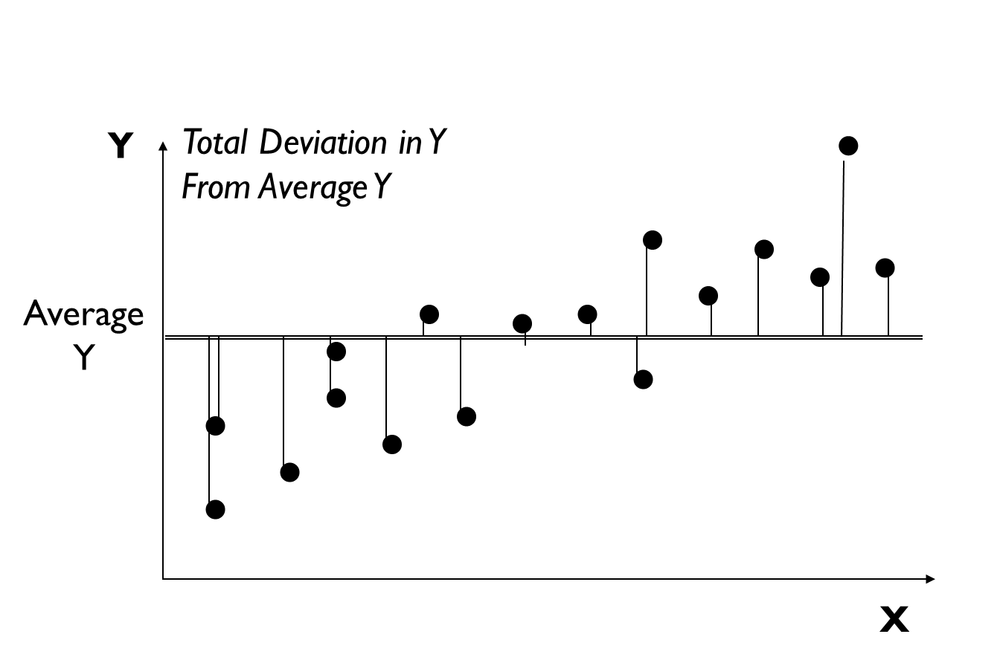
Regression Output – R²

Slide 25
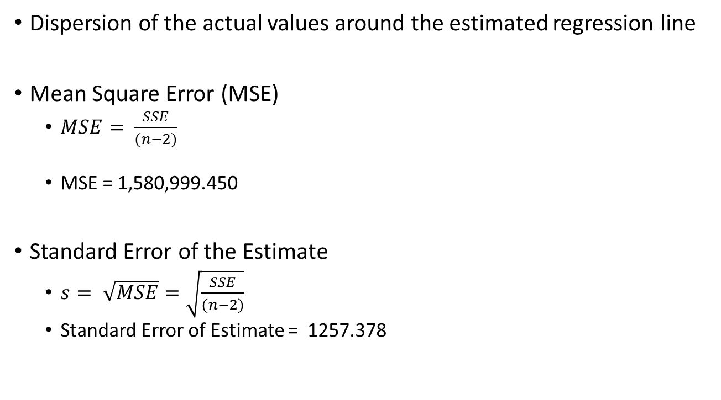
Standard Error of Estimate
Dispersion of the actual values around the estimated regression line
Mean Square Error (MSE)
$MSE= \frac{SSE}{(n−2)}$
MSE = 1,580,999.450
Standard Error of the Estimate
$s= \sqrt{MSE}=\sqrt{\frac{SSE}{(n−2)}}$
Standard Error of Estimate = 1257.378
n - Number of parameters estimated, b₀ and b₁
Notes:
The Mean Squared Error is intuitively similar to the variance
The variance is the dispersion around the mean, a point
The Mean Squared Error is the dispersion around the regression line
The Standard Error of the Estimate is intuitively similar to the standard deviation
It is the square root of the Mean Squared error
Just as the standard deviation is the square root of the variance

